Slide 1
Tafseer: Surah Yusuf
Part 2

Slide 2
إِذْ قَالَ يُوسُفُ لِأَبِيهِ يَا أَبَتِ إِنِّي رَأَيْتُ أَحَدَ عَشَرَ كَوْكَبًا وَالشَّمْسَ وَالْقَمَرَ رَأَيْتُهُمْ لِي سَاجِدِينَ
“My dear father…”
Hinted he understood
Repeating: Emphasises he stopped.
Shows shock in conveying dream
Star but specific type…

Slide 3
Showing Kindness to Parents
“And We have enjoined on man to be dutiful and kind to his parents” [al-Ahqaaf 46:15]
“And We have enjoined on man to be dutiful and kind to his parents” [al-‘Ankaboot 29:8]
“But behave with them in the world kindly” [Luqmaan 31:15]

Slide 4
إِذْ قَالَ يُوسُفُ لِأَبِيهِ يَا أَبَتِ إِنِّي رَأَيْتُ أَحَدَ عَشَرَ كَوْكَبًا وَالشَّمْسَ وَالْقَمَرَ رَأَيْتُهُمْ لِي سَاجِدِينَ
“My dear father…”
Hinted he understood
Repeating: Emphasises he stopped.
Shows shock in conveying dream
Star but specific type…

Slide 5
Dreams in Islam
Abu Hurayrah narrated that the Prophet (peace be upon him) said:
“There are three types of dreams: a righteous dream, which is glad tidings from Allah; the dream which causes sadness is from Satan; and a dream from the ramblings of the mind.”
1. Divine Dreams
2. Satanic Dreams
3. Human Dreams

Slide 6
The Etiquette of Dreams
Bad Dream | Good Dream
He should refuge in Allah. [Bukhari and Muslim] | He should praise Allah. [Bukhari and Muslim]
He should lightly spit to his left thrice. [Bukhari and Muslim] | He can mention it to others. [Bukhari and Muslim]
 | He should pray 2 units of prayer. [Muslim]
Ibn Hajar said: to sum up what has been said about good dreams, we may say three things:
A person should praise Allaah for the good dream
He should feel happy about it
He should talk about it to those whom he loves but not to those whom he dislikes.
To sum up what has been said about bad dreams, we may say four things:
He should seek refuge with Allaah from the evil of the dream.
He should seek refuge with Allaah from the evil of the Shaytaan.
He should spit to his left three times when he wakes up.
He should not mention it to anyone at all.

Slide 7
Interpreting Dreams
A knowledge which has largely been lost…
Imam al-Baghawi said:
Know that the interpretation of dreams falls into various categories. Dreams may be interpreted in the light of the Qur’aan or in the light of the Sunnah, or by means of the proverbs that are current among people, or by names and metaphors, or in terms of opposites. (Sharh al-Sunnah, 12/220)

Slide 8
Interpreting Dreams (Cont.)
Imam al-Baghawi gaves examples of this:
Quran | Interpretation in the light of the Qur’aan: such as a rope meaning a covenant, Allah says: “And hold fast, all of you together, to the Rope of Allaah…” [Aal ‘Imraan 3:103]
Sunnah | Interpretation in the light of the Sunnah: such as the crow representing an immoral man (faasiq), because the Prophet (peace and be upon him) called it such.
Proverbs | Interpretation by means of proverbs: such a digging a hole meaning a plot, because people say “Whoever digs a hole will fall in it.”
Names | Interpretation by means of names: such as seeing a man called Raashid meaning wisdom.
Opposities | Interpretation by means of opposites: such as fear meaning safety, because Allah says: “And He will surely give them in exchange a safe security after their fear” [al-Noor 24:55]

Slide 9
قَالَ يَا بُنَيَّ لَا تَقْصُصْ رُؤْيَاكَ عَلَىٰ إِخْوَتِكَ فَيَكِيدُوا لَكَ كَيْدًا ۖ إِنَّ الشَّيْطَانَ لِلْإِنسَانِ عَدُوٌّ مُّبِينٌ
“My dear son…”
“Outright” or “clear.”

Slide 10
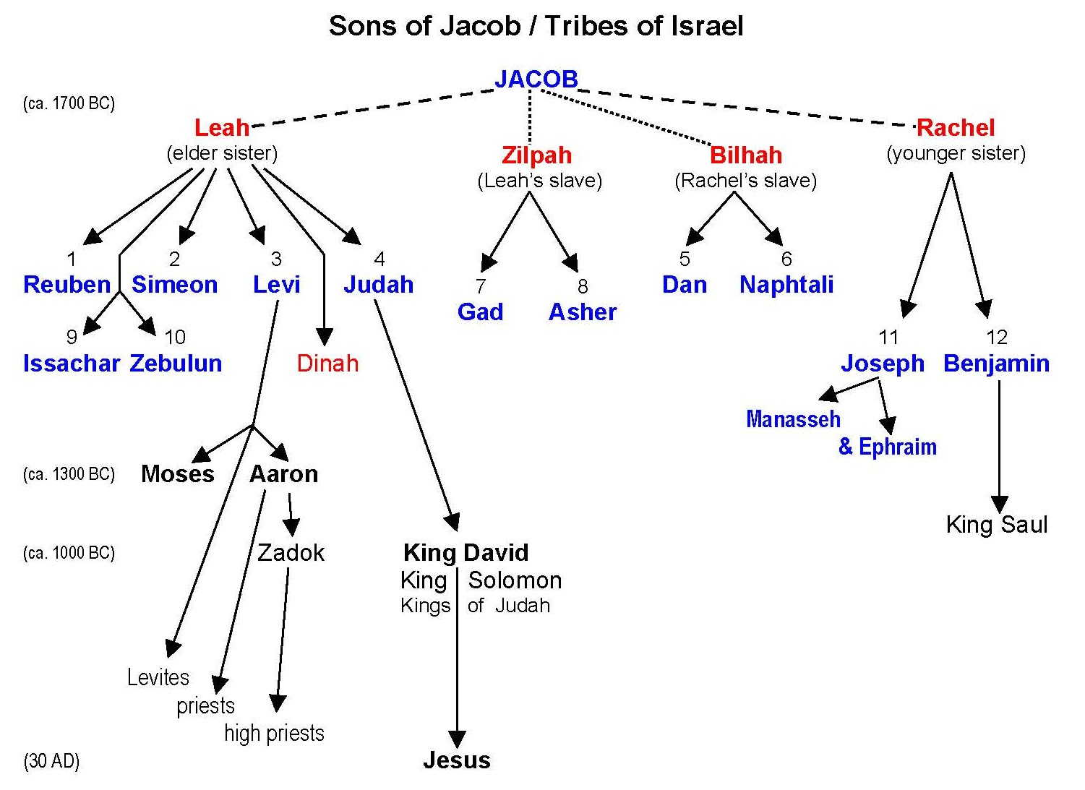
The Brothers of Yusuf
روبيل (1
شمعون (2
ولاوى (3
ويهوذا (4
وزيالون (10
ويشجر (9
دان (5
ونفتالي (6
وجاد (7
وأشر (8

Slide 11
الأحاديث
1) Interpretations of dreams. 2) Interpretations of things which are not clear.
تأويل
Means = “interpret”
أفتى = Figure out something hard
تعبير= Figure out dreams
يَجْتَبِيكَ
Means = “Choose you”
from اجتب
اصطفى = Chosen due to purity
اختر = Chosen due to goodness
اجتب = Chosen due to qualifications
Parenting Lessons:
1 – Prophet Ya’qub is praising his son, giving him positive attention for his future, making him confident and giving him encouragement of him having a good future. All this and Yusuf has not even done anything except have a dream.
2 – Even though Prophet Ya’qub warned his son first about not narrating the dream to his brothers, we see that he followed it with praises and Positive encouragement. So parents need to do both warn and praise to guide their children.

Slide 12
لَّقَدْ كَانَ فِي يُوسُفَ وَإِخْوَتِهِ آيَاتٌ لِّلسَّائِلِينَ
The Mushrikeen
‘Brothers’ to the Prophet (peace be upon him).
Also guilty of treachery.
Same result will occur

Slide 13
إِذْ قَالُوا لَيُوسُفُ وَأَخُوهُ أَحَبُّ إِلَىٰ أَبِينَا مِنَّا وَنَحْنُ عُصْبَةٌ إِنَّ أَبَانَا لَفِي ضَلَالٍ مُّبِينٍ
A seperation…
Clear error…
1. According to Ibn al-Farris:
عُصْبَةٌ = Strong group (5 to 10)
People do not fight such a group out fear that they will fight back.
2. Benefits
By calling themselves an ‘usbah, they are denying 2 other brothers.
‘Asabiyyah – Group Pride/Prejudice + strength (comes from ‘uSbah).

Slide 14
Is it blameworthy to love one more child than the other?

Slide 15
What did the Prophet say about Jealousy?
Al-Tirmidhi narrates that the freed slave of al-Zubayr said:
“The Prophet said, ‘The disease of the nation who came before you has started to spread among you: jealousy and hatred. This is the shaver [destroyer]; I do not say that it shaves hair, but it shaves [destroys] faith. By the One in Whose Hand is my soul, you will not enter paradise until you believe, and you will not believe until you love one another. Shall I not tell you of that which will strengthen the love between you? Spread [the greeting of] Salaam among yourselves’.”

Slide 16
Discuss ways to eradicate or decrease jealousy?

Slide 17
اقْتُلُوا يُوسُفَ أَوِ اطْرَحُوهُ أَرْضًا يَخْلُ لَكُمْ وَجْهُ أَبِيكُمْ وَتَكُونُوا مِن بَعْدِهِ قَوْمًا صَالِحِينَ
طرح
To throw away something worthless
“Kill Yusuf!”
News of the dream leaked out.
خلى
To leave alone.
To abandon.
“We shall be righteous people…”
They blame Yusuf for lack of righteousness.
They think that this sin will not ‘haunt’ them.

Slide 18
It is apparent from this ayah…
Brothers are talking about repentance before the crime.
Shaytan convinves one that it is okay to sin.
Sins give rise to more sins.
Anger and jealousy lead to sin.
The brothers have a twisted concept of love.

Slide 19
Twisted Love
Twisted ideas of love can cause people to do evil.
Story of Habil and Qabil.
The Brothers were guilty o attempted murder and kidnap because of a twisted love for their father.
The Wife of Aziz will do a serious crime (attempted zina/adultery and indirectly throwing Yusuf in prison) out of twisted love.

Slide 20
قَالَ قَائِلٌ مِّنْهُمْ لَا تَقْتُلُوا يُوسُفَ وَأَلْقُوهُ فِي غَيَابَتِ الْجُبِّ يَلْتَقِطْهُ بَعْضُ السَّيَّارَةِ إِن كُنتُمْ فَاعِلِينَ
Ghayaabah – a Concealer (this word is also used for “Grave.”)
Implies he is angry with Yusuf…
Rubil [Ibn Katheer]
Stumble across…
Hole in the ground….

Slide 21
قَالُوا يَا أَبَانَا مَا لَكَ لَا تَأْمَنَّا عَلَىٰ يُوسُفَ وَإِنَّا لَهُ لَنَاصِحُونَ
Ghunna (nasal) sound which extends the ‘N’ sound).
Implies they are extending their pleas to their father to take Yusuf outside with them;
1 – Fi’l Nahy [Laa ta'man-naa] – ‘(Dad) Don’t trust us then.’ (Reverse psychology against their dad using sarcasm.)
2 – Laa ta’manU naa (Raf’) – You don’t trust us (dad).
Like Shaytaan, claiming to be sincere when intending evil.
They are being devilish with Yusuf.
Endearing
They all said…

Slide 22
Sincerity for Yourself
Ibn al-Qayyim (may Allah have mercy on him) said:
A person can have nothing more beneficial than sincerity towards his Lord in all his affairs, along with sincerity of resolve, so he should be sincere towards Him in his resolve and in his actions. [al-Fawaid, p. 186]

Slide 23
أَرْسِلْهُ مَعَنَا غَدًا يَرْتَعْ وَيَلْعَبْ وَإِنَّا لَهُ لَحَافِظُون
“We will definitely protect him…”
Next day OR ‘in the Morning’
‘He will enjoy it’ yaRta3 – Rata3a = when animals graze (eat).
Meaning: he will enjoy it so much, just like how animals eat when they get food after a long time.

Slide 24
The Permissibility of Playing
Ayesha (may Allah be pleased with her) relates:
“I swear by Allah that I saw Allah’s Messenger standing at the door of my room while the Abyssinians were engaged in spear-play in the mosque of Allah’s Messenger. He screened me with his cloak so that I could watch them perform. He stood there for my sake until I decided that I had had enough. Now just imagine how much time a young girl eager for entertainment would stand there watching.” (Bukhari and Muslim)
Guidelines for entertainment in Islam
Must be lawful.
Must not cause us to neglect duties.
It should have some benefit.
It should not take up too much of our time.

Slide 25
قَالَ إِنِّي لَيَحْزُنُنِي أَن تَذْهَبُوا بِهِ وَأَخَافُ أَن يَأْكُلَهُ الذِّئْبُ وَأَنتُمْ عَنْهُ غَافِلُونَ
“Surely it depresses me…”
“I fear…”
“I fear that a wolf will devour him…”

Slide 26
Scholarly Commentaries
Scholars derived the following benefits from this ayah:
It is permissible for one to feel sadness.
One should avoid giving the opposition possible excuses.
An obedient child avoids that which his own parents are afraid of.
Parents should trust their children from the outset.

Slide 27
قَالُوا لَئِنْ أَكَلَهُ الذِّئْبُ وَنَحْنُ عُصْبَةٌ إِنَّا إِذًا لَّخَاسِرُونَ
“We will be losers..”
Irony: They do become losers…

Slide 28
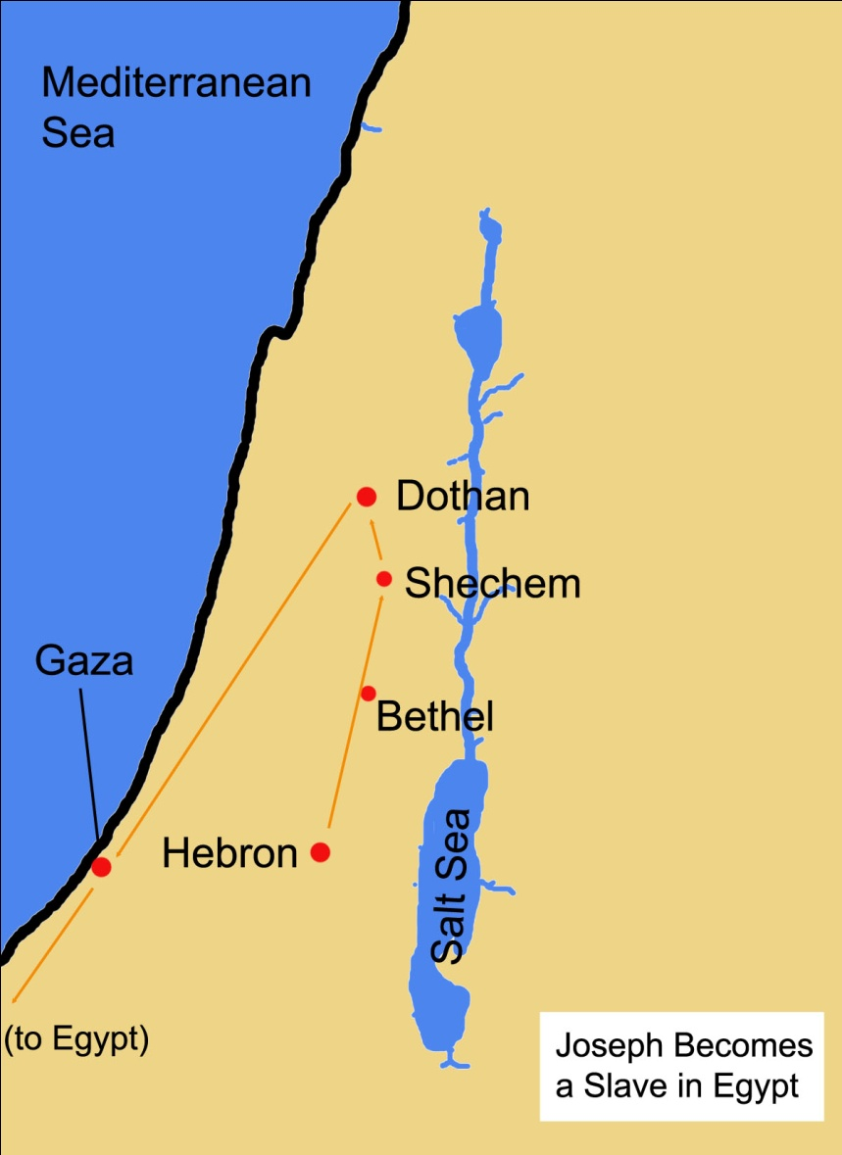
Where do they go?

Slide 29
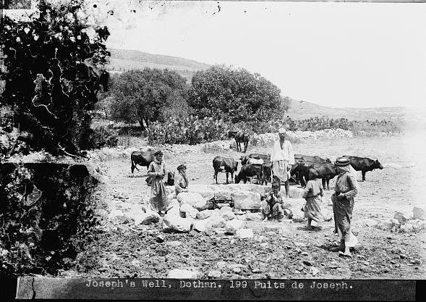
The Well of Yusuf

Slide 30
…فَلَمَّا ذَهَبُوا بِهِ وَأَجْمَعُوا أَن يَجْعَلُوهُ فِي غَيَابَتِ الْجُبِّ
Ghayaabah – a Concealer (this word is also used for “Grave.”)
A hidden well with shallow water.
All of them agreed…

Slide 31
وَأَوْحَيْنَا إِلَيْهِ لَتُنَبِّئَنَّهُم بِأَمْرِهِمْ هَٰذَا وَهُمْ لَا يَشْعُرُونَ…
Ghayaabah – a Concealer (this word is also used for “Grave.”)
A hidden well with shallow water.
Naba’ = knowledge/news which is Great/Big news.
None can tell it except the one who knew it (i.e. not easy knowledge to find out yourself).
This is why Prophets are called Nabi'.

Slide 32
وَجَاءُوا أَبَاهُمْ عِشَاءً يَبْكُونَ

