Slide 1
Ahkam Altajweed
Rewayat Hafs 'An 'Aasim by the way of Shaatibiyyah
CANBERRA MOSQUE
Week 4
MAKHRAJ AL LISSAN (Tongue) Part 3
12 Rajab 1434

Slide 2
Main Makhaarij
There are 5 main categories of Makhaarij:
1. The oral cavity Al Jawf اﻟﺠََﻮف
2. The throat Al Halq اﻟﺤَﻠﻖ
3. The tongue Al Lissaan اللِّسَان
4. The lips Ash-shafatain اﻟﺸَّﻔَﺘﺎن
5. The nasal cavity Al Khayshoom اﻟﺨَﻴﺸُﻮم

Slide 3
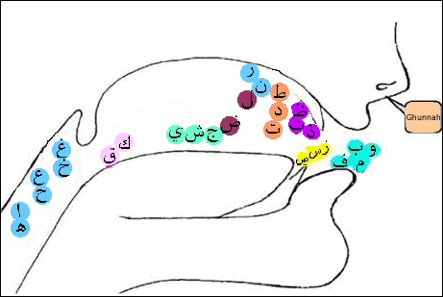
A diagram showing where each letter originates

Slide 4
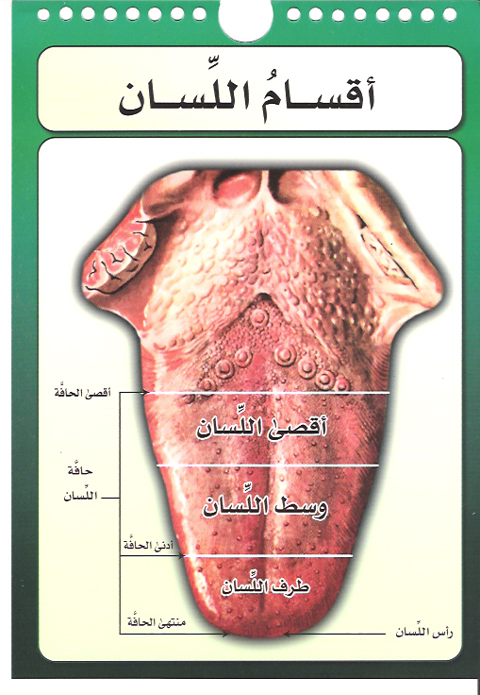
Tongue parts

Slide 5
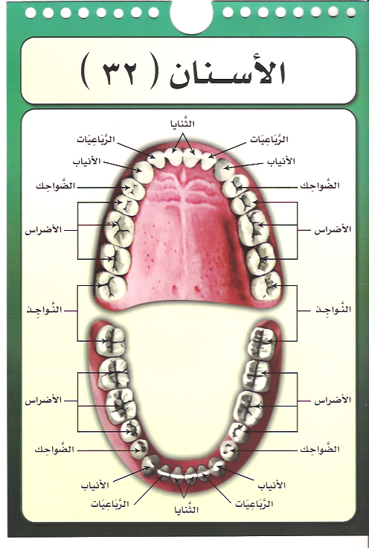
Teeth

Slide 6
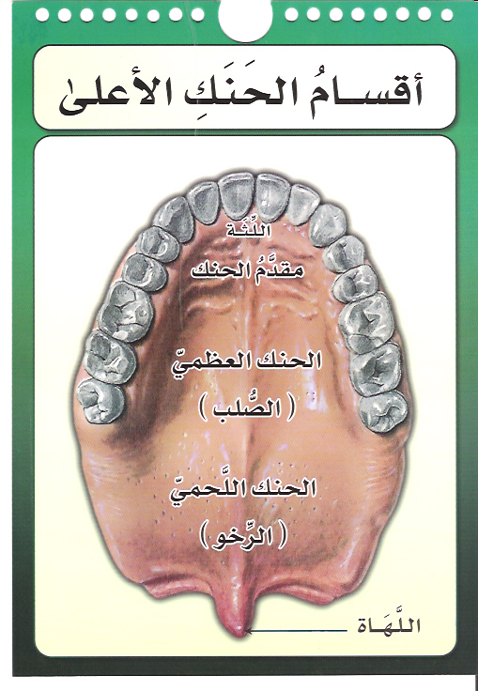
Parts of the upper palate

Slide 7
8th sub-makhraj of the tongue
From the top part of the tip of the tongue and the gum line of the two top incisors
Three letters come from this sub-makhraj which are (ط،د،ت)

Slide 8
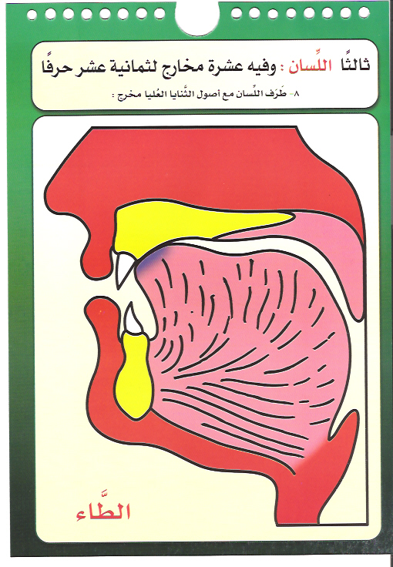
A diagram showing the makhraj of (ط)

Slide 9
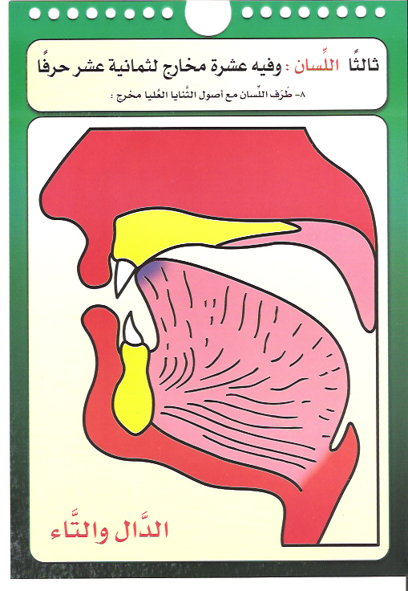
A diagram showing the makhraj of (د،ت)

Slide 10
Examples of the letter (ط)
وَٱلطُّورِ وَكِتَٰبٍۢ مَّسْطُورٍۢ (2-52:1) ۞ تَطْمَئِنُّ ٱلْقُلُوبُ (13:28) ۞ يَبْسُطُ ٱلرِّزْقَ (42:12) ۞ طَآئِفَةٌ أُخْرَىٰ (4:102) ۞ بِسُلْطَٰنٍۢ مُّبِينٍ (52:38)

Slide 11
Examples of the letter (د)
وَأَيَّدْنَٰهُ بِرُوحِ ٱلْقُدُسِ (2:87) ۞ وَٱللَّهُ بَصِيرٌۢ بِٱلْعِبَادِ (3:15) ۞ وَٱلْأَرْضَ مَدَدْنَـٰهَا (50:7) ۞ وَلَدَارُ ٱلْءَاخِرَةِ (12:109) ۞
مَّتَٰعَ ٱلْحَيَوٰةِ ٱلدُّنْيَا (10:23) ۞ ٱلَّتِى تَطَّلِعُ عَلَى ٱلْأَفْـِٔدَةِ (104:7)

Slide 12
Examples of the letter (ت)
تَبَّتْ يَدَآ أَبِى لَهَبٍۢ وَتَبَّ (111:1) ۞
أَتْمِمْ لَنَا نُورَنَا (66:8) ۞ تَارَةً أُخْرَىٰ (20:55) ۞ كِتَـٰبًۭا مَّوْقُوتًۭا (4:103) ۞ وَٱلتِّينِ وَٱلزَّيْتُونِ (95:1)

Slide 13
9th sub-makhraj of the tongue
From the tip of the tongue and the lower incisors
Three letters come from this sub-makhraj which are (ص،س،ز)

Slide 14
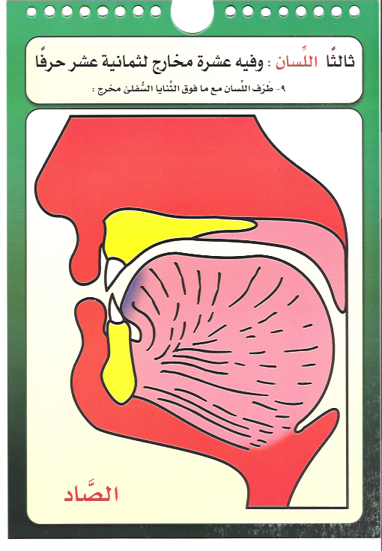
A diagram showing the makhraj of (ص)

Slide 15
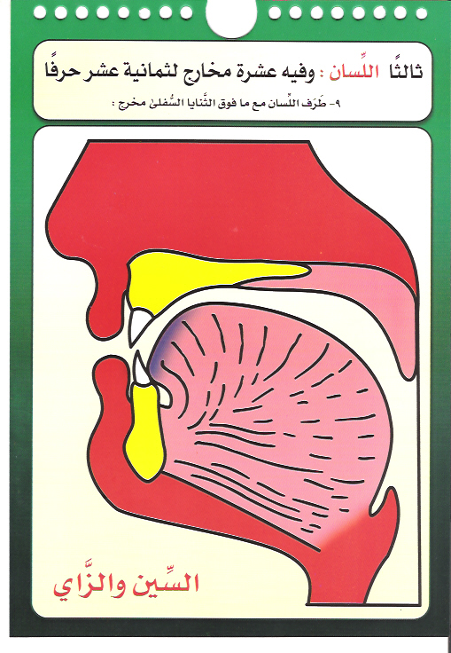
A diagram showing the makhraj of (س،ز)

Slide 16
Examples of the letter (ص)
تَصْلَىٰ نَارًا حَامِيَةًۭ (88:4) ۞ صَبَبْنَا ٱلْمَآءَ صَبًّۭا (80:25) ۞ بُكْرَةًۭ وَأَصِيلًا (48:9) ۞ وَأَقِيمُوا۟ ٱلصَّلَوٰةَ (2:43) ۞ ءَامَنُوا۟ صَلُّوا۟ عَلَيْهِ (33:56)

Slide 17
Examples of the letter (س)
وَأَيَّدْنَٰهُ بِرُوحِ ٱلْقُدُسِ (2:87) ۞ سَأَلَ سَآئِلٌۢ (70:1) ۞ لَا يَسْخَرْ قَوْمٌۭ مِّن قَوْمٍ (49:11) ۞ سَلْسَبِيلًۭا (76:18) ۞ سَيَقُولُ ٱلسُّفَهَآءُ (2:142) ۞
مِن شَرِّ ٱلْوَسْوَاسِ ٱلْخَنَّاسِ ٱلَّذِى يُوَسْوِسُ فِى صُدُورِ ٱلنَّاسِ مِنَ ٱلْجِنَّةِ وَٱلنَّاسِ (6-114:4)

Slide 18
Examples on letter (ز)
وَخَلَقْنَٰكُمْ أَزْوَٰجًۭا (78:8) ۞ إِذَا زُلْزِلَتِ ٱلْأَرْضُ زِلْزَالَهَا (99:1) ۞ ُفَقَدْ فَازَ فَوْزًا عَظِيمًا (33:71) ۞ وَأَنزَلْنَا مِنَ ٱلسَّمَآءِ مَآءًۭ طَهُورًۭا (25:48) ۞ أَزْوَٰجًۭا لِّتَسْكُنُوٓا۟ إِلَيْهَا (30:21)

Slide 19
10th sub-makhraj of the tongue
From the top part of the tip of the tongue and the bottom edge of the two top incisors
Three letters come from this sub-makhraj which are (ظ،ذ،ث)

Slide 20
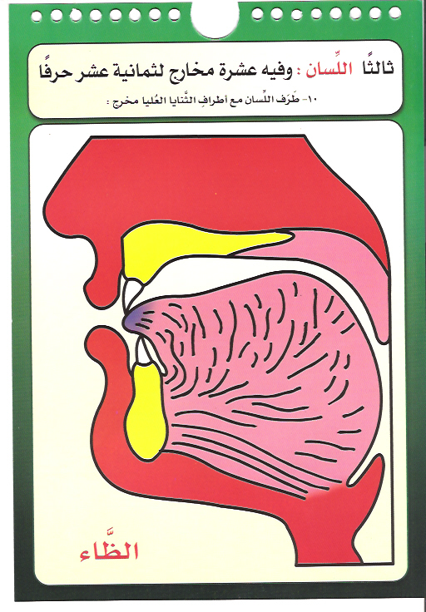
A diagram showing the makhraj of (ظ)

Slide 21
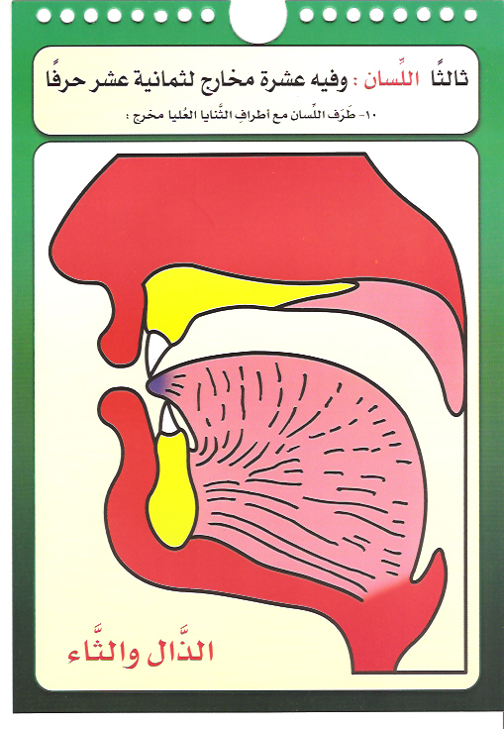
A diagram showing the makhraj of (ذ،ث)

Slide 22
Examples on letter (ظ)
مِنَ ٱلظَّٰلِمِينَ (2:35) ۞ وَإِذَآ أَظْلَمَ عَلَيْهِمْ قَامُوا۟ (2:20) ۞ رَبَّنَا ظَلَمْنَآ أَنفُسَنَا (7:23) ۞ مِن ظُهُورِهِمْ (7:172) ۞ وَإِن نَّظُنُّكَ لَمِنَ ٱلْكَٰذِبِينَ (26:186) ۞ غَلِيظَ ٱلْقَلْبِ (3:159) ۞ وَمَنْ أَظْلَمُ مِمَّنِ ٱفْتَرَىٰ عَلَى ٱللَّهِ كَذِبًا (6:93)

Slide 23
Examples on letter (ذ)
َٰٓأَيُّهَا ٱلَّذِينَ ءَامَنُوا۟ ٱذْكُرُوا۟ ٱللَّهَ ذِكْرًۭا كَثِيرًۭا (33:41) ۞ لَأُعَذِّبَنَّهُۥ عَذَابًۭا شَدِيدًا (27:21) ۞ وَإِذْ قَالَ إِبْرَٰهِۦمُ (2:126) ۞ وَيُعَذِّبُ مَن يَشَآءُ (48:14) ۞ مَن ذَا ٱلَّذِى يَشْفَعُ عِندَهُۥٓ إِلَّا بِإِذْنِهِۦ (2:255)

Slide 24
Examples on letter (ث)
وَثِيَابَكَ فَطَهِّرْ (74:4) ۞ وَبَثَّ فِيهَا مِن كُلِّ دَآبَّةٍۢ (31:10) ۞ مَثْنَىٰ وَثُلَٰثَ وَرُبَٰعَ (4:3) ۞ ثَالِثُ ثَلَٰثَةٍۢ (5:73) ۞ وَلَآ أَصْغَرُ مِن ذَٰلِكَ وَلَآ أَكْبَرُ إِلَّا فِى كِتَٰبٍۢ مُّبِينٍۢ (34:3)ۘ

Slide 25
Questions
What are the two conditions for (ا،و،ي) to be a long vowel?
What is the definition of Ilmu Altajweed and how it can be achieved?
What is the makhraj?
How do we now the makhraj of a specific letter?
Why we say that the long vowel has an approximate makhraj?
What are the main five makharej?
How many sub–makhraj are there in the throat and what are they?
What are the three letters come out from the middle of the tongue?

