Slide 1
Tafseer: Surah Yusuf
Part 1

Slide 2
Makki-Madani Classifications
Makki | Maddani
Before the Hijrah. | After the Hijrah.
Strong/harsh words. | Gentle style of address.
Shorter ayyat. | Longer ayaat.
Powerful impact, arguments and proofs. | Mention of rulings without proofs and reasoning.
Focus on Tawheed. | Detailed rulings concerning acts of worship and transaction.
Focus on stories of previous prophets. | Themes concerning Jews, Christians and munafiqeen.

Slide 3
Reasons for revelation
1. Test | 2. Best of stories
An attempt to discredit the Prophet (peace be upon him) when the Jews asked about the lineage of Ibrahim. | Al Hakim reportes that Sa’d ibn Abi Waqqas (may Allah be pleased with him) reported: Companions requested from the Prophet (peace be upon him): “Please relate to us stories.”
Another version: the Jews told the mushrikeen to question the Prophet (peace be upon him) about Yusuf and how the family of Yaqub moved from Palestine to Egypt. | In another narration by Sa’eed ibn Jubair (may Allah be pleased with him): The Companions asked the Prophet (peace be upon him): “Please remind us.”

Slide 4
1. Prophethood
3. Abu Talib’s death
5. Open enmity in Ta’if
4. Khadija dies
6. Migration to Madinah
Surah Yusuf was revealed at a difficult time for the Muslims
2. Muslims were boycotted in Shi’b Abi Taalib

Slide 5
Scholars disagree concerning the “Basmallah”
View 1) It is an ayah from amongst the ayaat of the Qur’an
View 2) It is not an ayah from the Qur’an.
View 3) It is an ayah only at the beginning of al-Fatihah. In another places it is used to separate suras.
View 4) According to some qira’aat it is an ayah, it is not according to others.
View 5) It is an independent ayah but not part of the surah.

Slide 6
Theoretical Evidence Supporting the Fifth View
The scholars who hold this view state that the writing of the Basmallah in the Qur’aan with the Qur’anic font (ar-rasm al-Uthmaani) is evidence that it is a part of the Qur’an.
Furthermore the Basmallah has been placed independently from the surahs it precedes, which proves that it is an entity in its own right and not part of the surahs.

Slide 7
The Disjointed Letters
ا ل ر
They are from the mutashabihaat of the Qur’an, their meaning is only known to Allah.
They serve the purpose of oaths in the Qur’an.
They are the names of Allah.
They stand for specific meanings.
A couplet of Arabic poetry mentioned by Ibn-Farris (d. 395) illustrates this:
“Qulnaa laha qifee faqalat qaaf.”
“We said to her stop and she said qaaf” [short for “waqaftu”].
They are references to the names of suras.
They serve as a reference to the other half of the Arabic alphabet.

Slide 8
تِلْكَ آيَاتُ الْكِتَابِ الْمُبِينِ
Implies something far
“Outright” or “clear.”

Slide 9
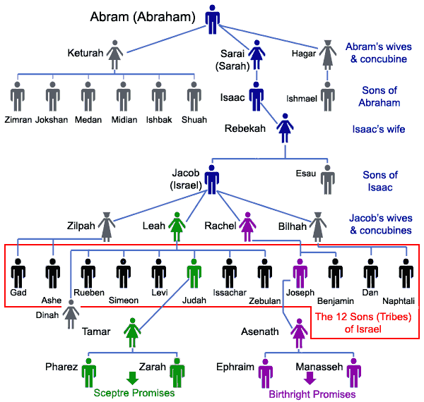
The Genealogy of Yusuf

Slide 10
إِنَّا أَنزَلْنَاهُ قُرْآنًا عَرَبِيًّا لَّعَلَّكُمْ تَعْقِلُونَ
“So that perhaps…”
“We revealed…”
“So that you may all understand…”
“An Arabic Qur’an…”

Slide 11
An Arabic Qur’an
Translations: Translations of the Qur’an into other than the Arabic languages are not termed al-Qur’an.
Tafseers: An explanation of the Qur’an in the Arabic language is not termed al-Qur’an.
Fiqh: The Islamic legislative rulings that are specific to the Qur’an do not apply to translations and explanations of the Qur’an.

Slide 12
Are there any non-Arabic words in the Qur’an?

Slide 13
Non-Arabic in the Qur’an
Scolars have unanimously agreed: That there are no non-Arabic sentences in the Qur’an.
إبراهيم
يعقوب
يوسف
Regarding other words, there are 3 views:
There are no foreign words.
There are foreign words.
There are foreign words but they have become ‘Arabized.’

Slide 14
Meaning of the Names
אַבְרָהָם “Father of many…” | إبراهيم
יוֹסֵף “He will add…” | يوسف
יַעֲקֹב “Holder of the heel…” “May God protect…” | يعقوب

Slide 15
Who is Yusuf?
Abu Hurayrah (may Allah be pleased with him) narrated that the Prophet (peace be upon him) was asked:
“Who is the most honourable of people?” He replied, “the most honourable is the one with the most taqwa.” The questioner said, “I am not asking about that,” so the Prophet said, “The most honoured is Yusuf , who was a prophet, son of a prophet, son of a prophet, son of Khaleel-Allah.” [Bukhari & Muslim]

Slide 16
نَحْنُ نَقُصُّ عَلَيْكَ أَحْسَنَ الْقَصَصِ بِمَا أَوْحَيْنَا إِلَيْكَ هَٰذَا الْقُرْآنَ
From the root “Khassa”. Meaning to trace footsteps.
We have revealed to you.

Slide 17
What makes a good story?

Slide 18
وَإِن كُنتَ مِن قَبْلِهِ لَمِنَ الْغَافِلِينَ
i.e. before the revelation…
Prophets known to the Arabs:
Ibrahim
Shu’ayb
Hud
Saleh
Isma’eel
Nuh
“Intellectually unaware…”

Slide 19
إِذْ قَالَ يُوسُفُ لِأَبِيهِ يَا أَبَتِ إِنِّي رَأَيْتُ أَحَدَ عَشَرَ كَوْكَبًا وَالشَّمْسَ وَالْقَمَرَ رَأَيْتُهُمْ لِي سَاجِدِينَ
“My dear father…”
Hinted he understood
Repeating: Emphasises he stopped.
Shows shock in conveying dream
Star but specific type…

Slide 20
Showing Kindness to Parents
“And We have enjoined on man to be dutiful and kind to his parents” [al-Ahqaaf 46:15]
“And We have enjoined on man to be dutiful and kind to his parents” [al-‘Ankaboot 29:8]
“But behave with them in the world kindly” [Luqmaan 31:15]

Slide 21
إِذْ قَالَ يُوسُفُ لِأَبِيهِ يَا أَبَتِ إِنِّي رَأَيْتُ أَحَدَ عَشَرَ كَوْكَبًا وَالشَّمْسَ وَالْقَمَرَ رَأَيْتُهُمْ لِي سَاجِدِينَ
“My dear father…”
Hinted he understood
Repeating: Emphasises he stopped.
Shows shock in conveying dream
Star but specific type…

