Slide 1
Fiqh of Riba
Part 3

Slide 2
Credit Sales Exception
Ibn Qudama (may Allah have mercy on him) explained that credit sales are permissible when currency is involved:
“The exception is that one of the two goods being traded is cash, in other words, currencies such as dirhams or dinars. When the other is monetary, it is then permissible for there to be a credit-basis between them and there is no difference of opinion.”

Slide 3
Examples of Explicit Riba Al-Fadhl
As discussed, scholars differ concerning the illa behind items which are subject to riba.
There is no difference of opinion concerning the matter. [Al-Mughni]
According to Fathul Baari (4/382), there is a consensus (ijma’).
Example 1:
That one sell gold for silver but part ways before possession.
Example 2:
That one sell a non-equal amount of gold for gold then separate before possession takes place.
Example 3:
That one sell a non-equal amount of gold for gold during a single sitting (majlis al-aqd).

Slide 4
Concerning the 3rd example…
There is a difference of opinion.
Example 3:
That one sell a non-equal amount of gold for gold during a single sitting (majlis al-aqd).
The nature of this difference in opinion:
A difference of opinion was made known through Umar ibn Al-Khattab (may Allah be pleased with him) and Ibn Abbas (may Allah be pleased with him). They however retracted their opinions and said it was impermissible.
Abu Saeed (may Allah be pleased with him) met him and conveyed through conversation, the Prophet’s () statement: فَمَنْ زَادَ فَهُوَ رِبا “Whoever increases then it is ribaa.” [Fath Al-Baari (4/382)]
Ibn Abbas (may Allah be pleased with them both) then said “I seek forgiveness in Allah and I repent to him.” From then onwards he used to was very strict in prohibiting it.

Slide 5
Riba and the Status of Paper Money in Islam

Slide 6
The Status of Paper-Money
What happened when paper-money was used:
“When gold and silver were used as a means of exchange between people, its practical use, as previously detailed through the sunnah, was clear and not obscure to anyone. Nevertheless, once banknotes became a form of exchange, gold and silver came to resemble a purchasable item.”
Approaching the issue:
“No doubt, it is difficult to prevent people from using what is necessary for them to use or to cause them to resort to a forbidden transaction in which they perceive themselves as disobeying Allah…”
There are 4 scholarly views concerning the status of paper-based currency.

Slide 7
The 1st View
That paper-monies are certified bills assigned by the issuer (i.e. debt certificates for the creditor on his debtor).
According to Ibn Uthaymeen (may Allah have mercy on him):
Those who proscribe to this view do not take into account that when receiving banknotes, they are accepting a certificate of debt.
This is impermissible as the sale of a debt to one who is not owed a debt is impermissible according to the majority.
The view which permits their use requires that rare circumstances exist when one uses such notes.

Slide 8
The 2nd View
That these banknotes are trade goods.
This implies that banknotes are to be considered as items which one may do business with such as:
Food
Clothing
Furniture
Livestock
Real estate and so forth.
This view is unrealistic as it necessitates:
“…the absence of zakah through adopting it.”
Even if one were to attain millions, they would be exempt as they would be perceived by its owner as property.
Observance of such a view implies the negation of zakah (with the exception of those who work as money-changers.)

Slide 9
The 3rd View
That these banknotes and their values fall under that which they are used instead of.
EXAMPLE: If linked to silver, they fall under the ruling of silver. If linked to gold, they fall under the ruling of gold.
Based on this view, the payment of zakah is obligatory (wajib).
Shaykh Ibn Uthaymeen (may Allah be pleased with him) said:
“This view, even if it is an opinion, involves difficulty for the people and obliges them to follow that for which there is no clear proof.”
“For if a person were to buy a necklace of gold in pounds sterling, it would be necessary for the necklace to be the same weight as the gold that the pound sterlings have been determined for the transaction to be correct.”
Likewise: “If he were to purchase a necklace of silver with Saudi Riyal notes, it would be necessary that the necklace be the same in weight of the silver which were determined to be Saudi Riyals for the transaction to be correct based on this view.”

Slide 10
The 4th View
That these banknotes are to be treated as currency, just as gold and silver were.
“The exception to this is ribaa al-fadhl, as the notes contain no inherit value.”
“…if a note is exchanged for two notes and possession takes place at the time of the transaction, there is no problem.”
This view is the most correct of all the views due to its strong foundation.
Shaykh Muhammad Rasheed Ridha said (P.839 in Vol. 3):
“Consequently, the difference of opinion within these important issues is that making banknotes akin to the two currencies implies that they be subject to ribaa. This is what we are able to determine. Whoever claims that they are trade offers, prevents the possibility of ribaa, and in this circumstance it becomes easy for anyone to devour a plentiful amount of ribaa with these notes which are no different to gold according to one of the economists. Similarly, the view that they fall under the ruling of certified bills leads to the mass use of ribaa and the prohibition of zakah, there is no need for further discussion. Whoever looks into the reality of this issue has been cautious with his religion by taking from that we have explained.”

Slide 11
Our Shaykh Abd Al-Rahman bin Sa’di (may Allah have mercy on him) was transcribed to have said on page 327 of “al-Fatawa al-Sa’diyah” during a debate between three others concerning the use of banknotes:
“So the fourth one amongst those that observed parity between the two proofs; the proof who viewed it as currency, the proof of those who viewed it as goods. Do you not see that if a person follows a view between the two statements and follows a way between the two ways by ruling that notes are considered under the ruling of money in a credit-based transaction, in this case he has prohibited the sale of ten, for example, to twelve on credit. This is because it is ribaa nasee’ah which the Muslims have agreed upon in regards to its unlawfulness. Likewise, those that prohibit ribaa fadhl, agree that it is even more unlawful and greater in sin that ribaa fadhl. The trade of some of them with others whilst present on spot regardless of whether they are similar or not is permissible because the prohibition of ribaa al-fadhl is merely a means towards ribaa nasee’ah and some scholars have permitted it even though it is proven by many shar’i proofs. Being that notes are in reality not considered money and due to the situation of need it is perhaps the reason cause taking this view to be appointed and allowable. This particular view balanced between the two and the aforementioned details are those which may be followed as an opinion with adherence to the intents of the shari’ah.”
He also said (p. 329):
“So the need (hajjah), rather the necessity (dhururah) that they not be considered as ribaa an-nasee’ah and being that the notes are not intrinsically considered gold and silver in spite of the difference of opinion of the people of knowledge concerning this ruling is what allows this view, rather it allows preference of it, and Allah knows best.”
What is meant by the view that has been preferred is that it is prohibited for ribaa an-nasee’ah in the exchange of notes with others and it is conceivable for ribaa al-fadhl to enter, thus they are to transacted whilst present, on the spot. And this, as we have mentioned earlier is closest to that which is correct due to its strength in justification. And Allah knows best.
i.e. gold and silver
From a legalistic perspective.

Slide 12
‘Eenah Transactions

Slide 13
What is it?
An ‘Eenah transaction means:
To sell something for a price on credit, then buy it back for a lower price to be paid immediately.
This means:
That the buyer acquires cash and will pay back a higher amount after a while, so it is as if it is a loan in the form of a sale.

Slide 14
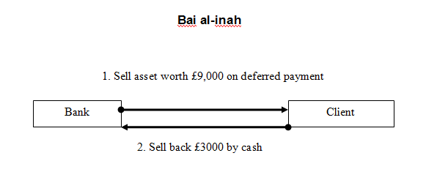
Example:

Slide 15
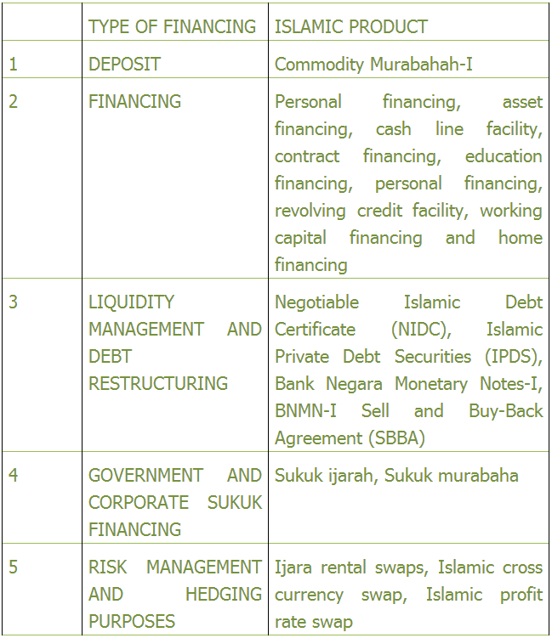
Application of ‘Eenah
Scholars in Malaysia and Brunei have allowed it.
It forms the basis for many transactions.

Slide 16
The Status of ‘Eenah
Muhammad ibn Hasan al-Shaybani (may Allah have mercy on him) said:
“I feel very distressed about this type of transaction; this transaction was invented by consumers of riba.” [Fath al-Qadeer (7/213)]
Ibn ‘Uthaimeen (may Allah have mercy on him) said:
“An example of an ‘eenah transaction is if I sell Zayd a car for twenty thousand to be paid in a year’s time, then I buy it back from this man for eighteen thousand; this is haraam and is not permissible, because it is using a trick to sell the car in an illusionary transaction for twenty thousand, then I go back and buy it for eighteen thousand in cash, so he will have taken it from me for eighteen thousand but he will pay me for twenty thousand and this is riba, so it is not permissible, because it is an obvious trick.”

Slide 17
Proof of Prohibition
Ibn ‘Umar (may Allah be pleased with him) who said: I heard the Messenger of Allah (peace be upon him) say:
“When you enter into ‘eenah transactions, take hold of the tails of cattle and are content with farming, and you forsake jihad, Allah will cause humiliation to prevail over you and will not withdraw it until you return to your religion.”
Source: Narrated by Abu Dawood (3462) and classed as saheeh by al-Tabari inMusnad Ibn ‘Umar (1/108); Ibn Taymiyah in Majmoo’ al-Fataawa (29/30) and al-Albaani in al-Silsilah al-Saheehah (no. 11).

Slide 18
Further Proof
Imam ‘Abd al-Razzaaq al-San’aani included a chapter in his al-Musannaf (8/184) entitled “Chapter on a man who sells a product then wants to buy it back for cash”:
“O Mother of the Believers, I had a slave girl. I sold her to Zayd ibn Arqam for eight hundred to be paid at a later date, then I bought her from him for six hundred, and I gave him six hundred in cash, but it was recorded as eight hundred. ‘Aa’ishah said: What a bad transaction you have done, by Allah! What a bad transaction he has made, by Allah! Tell Zayd ibn Arqam that he has cancelled out his jihad with the Messenger of Allah (peace be upon him) unless he repents.
The woman said to ‘Aa’ishah: Do you mean that I should take my capital and return the extra amount to him? She said: “So whosoever receives an admonition from his Lord and stops eating Ribaa, shall not be punished for the past; his case is for Allaah (to judge); but whoever returns (to Ribaa), such are the dwellers of the Fire — they will abide therein” [al-Baqarah 2:275]. Or she said: “but if you repent, you shall have your capital sums. Deal not unjustly (by asking more than your capital sums), and you shall not be dealt with unjustly (by receiving less than your capital sums)” [al-Baqarah 2:279]. End quote.
Ibn ‘Abd al-Haadi said in Tanqeeh al-Ta’leeq (2/558): its isnaad is jayyid. It was classed as saheeh by al-Zayla’i in Nasb al-Raayah (4/16)

Slide 19
Tawarruq Transactions

Slide 20
What is Tawarruq?
Linguistically: The term Tawarruq itself, is derived from the Arabic word “al-wariq” which linguistically refers to silver dirhams.
So called, because buyers used to sell commodity using paper, with the purpose of obtaining liquidity and not the commodity.
Technical definition: “Purchasing on credit and then selling at spot value with the objective of gaining cash.” [Muhammad Ayub, Understanding Islamic Finance, (John Wiley & Sons, 2007) 349.]

Slide 21
Significance of Tawarruq
Umar Ibn Abdul-Aziz said Tawarruq was the brother of riba. [Fatawa Islamiyah, Islamic Verdicts, Volume 4, (Darussalam, 2001) 364.]
This is alarming as Tawarruq has been the basis of many credit card transactions in the GCC and Bursa Malaysia.
Banks and legal firms broadcast having arranged multi-billion dollar facilities on their clients’ behalf.
This indicates that many billions of dollars worth of notional are changing hands. [Nikaa Firoozye, Tawarruq: Shariah Risk or Banking Conundrum, Opalesque Islamic Finance Intelligence, (Opalesque Ltd, 2009) 4.]

Slide 22
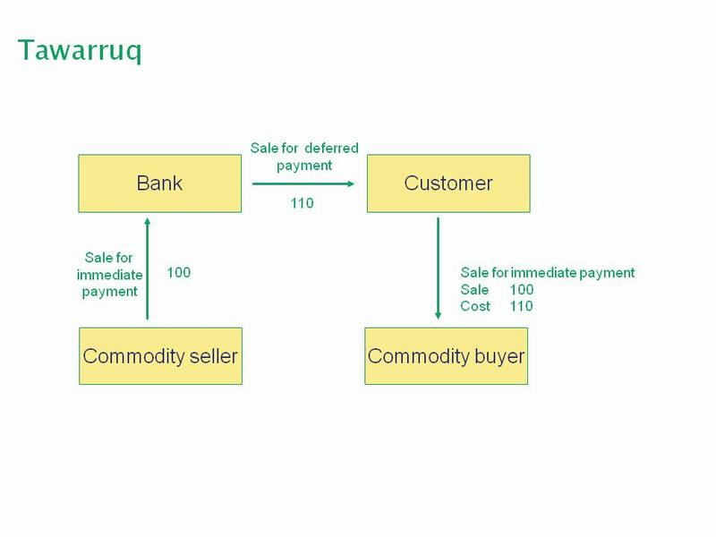
Example:

Slide 23
Three Positions
1) Those that argued for its permissibility
2) Those that argued it was disliked
3) Those that argued that it was impermissible

Slide 24
1st View: “Permissible”
Shaykh Abdul Aziz bin Baz (may Allah have mercy on him) summarised the position of those that believed Tawarruq to be permissible:
“With regard to the issue of Tawarruq, it is not riba and the correct view is that it is permissible, because of the general meaning of the evidence and because it facilitates relief and enables people to meet their current needs. As for the one who sells it to the one from whom he bought it, this is not permissible, rather this is a riba-based transaction, which is called ‘eenah. This is unlawful because it is a trick aimed at getting around the prohibition on riba.” [Majmoo Fatawa Ibn Baaz, 19/245]

Slide 25
2nd View: “Disliked”
Hanafi scholars such as:
Muhammad ibn al-Hassan al-Shaybaani (d. 850 CE)
Ibn al-Humaam (d. 861 AH/1457 CE)
Argued that although Tawarruq may not be impermissible (haram), its use is disliked (makruh) and should be avoided. [Muhammad bin Ibrahim al-Musa, Abdullah bin Muhammad al-Tayyar & Abdullah bin Muhammad al-Mutlaq, al-Fiqh al-Muyassar – Qism al-Mu’amalaat, (Madar al-Watan, 2005) vol. 1, 33.]
Shaykh Ibn ‘Uthaymeen said that Tawarruq is permissible as long as it is subject to conditions. [Risaalah al-Mudaayanah]

Slide 26
3rd View: “Prohibited”
Those that argued for its prohibition included Imam Ahmed.
According to one of the two recorded opinions held by him on the matter; he explained that Tawarruq was in reality:
The sale of a coerced person.
A kind of ‘eenah transaction.
Ibn Taymiyah further drew parallels between it and ‘eenah:
“The precise economic substance for which riba was forbidden is present in this contract, and transactions costs are increased through purchase and sale at a loss of some commodity” Ibn al-Qayyim al-Jawziyah, Ma’alim As-Sunan wa Tahdheeb Ibn al-Qayyim, (Dar al-Kutub al-‘Ilmiyah, 2000), vol. 5, 801.
He explains that:
The reason (illah) for riba’s prohibition is carried out through Tawarruq.
It is illogical for the shariah to prohibit a smaller harm, (i.e. riba) and yet allow a much greater harm in the form of Tawarruq.

Slide 27
Organized Tawarruq
What is Organized Tawarruq?
After commodity is bought on credit terms from a bank, the bank is made into an agent in order to sell the commodity which the buyer has not received. Banks commission sellers on the customer’s behalf,
Difference between Organized and Classical Tawarruq:
Classical Tawarruq physically deals with commodity (the commodity may or may not ultimately be sold).
Classical Tawarruq involves a genuine purchase whereas organized Tawarruq guarantees return and takes the difference between deferred price and cash price.

Slide 28
Organized Tawarruq: Prohibited
According to the Fiqh Council’s resolution 179:
“It is not permissible to execute both organized and reverse Tawarruq as simultaneous transactions occurs between the financier and the mustawriq, whether it is done explicitly or implicitly or based on common practice in exchange for a financial obligation. This is considered deception, i.e. in order to get the additional quick cash from the contract. Hence, the transaction is considered as containing the element of riba.”
In place of Commodity Murabaha, the Fiqh Council recommended the use of qard hassan.

Slide 29
Response from Bankers
Azizul Azmi Adnan, partner of the Islamic banking practice group of Wong & Partners (a member firm of Baker & McKenzie International) said that:
“While the use of instruments such as commodity murabahah may not be in strict compliance with the rulings of the OIC Fiqh Academy, or similar academies, it is necessary to consider the application of Islamic finance in the real world.”

Slide 30
Fiqh Council’s Response
The Fiqh Council’s own rationale in giving such a ruling was:
"to ensure that Islamic banking and financial institutions adopt investment and financing techniques that are Shariah-compliant in all activities. All transactions must conform to Shariah rules in order to ensure it meets the objectives of Shariah (maqasid shariah).”
They affirm that such practices will:
“ensure the progress and actualization of the socio-economic objectives of the Muslim world” [Mushtak Parker, ‘Tawarruq resolution raises many questions’, Arab News (Online), 22 June 2009]

